Slide 1


Benefit Education Session
All About Aetna
July 5, 2022
Notes:
This training is to provide an overview of benefits offered in Canada. To get more detailed information review the Vendor documents and plan guides

Slide 2
Agenda
Overview of Plans under Aetna
Medical
Virtual Primary Care
Teladoc
Minute Clinics
Aetna Supplemental Plans
Aetna EAP
Aetna Resources

Slide 3
Overview of Plans
Aetna provides numerous benefits to Brookfield employees which include:
Medical
Teladoc
  Virtual Primary Care
  CVS Minute Clinics
Aetna Supplemental plans
  Critical Illness
  Hospital Indemnity
  Accident
Aetna Resources For Living (EAP)
Aetna Resources
  Aetna Concierge
  24-hour Nurse Line

Slide 4
Medical Plan
You can enroll in the medical plans during your hire, Open Enrollment or Qualified Life Event such as, Birth/Adoption, Marriage, Loss of coverage, etc
You have access to your medical plan and prescription benefits through Aetna
Group number: 143749
Aetna provides three plans;
  Exclusive Provider Organization (EPO), all covered services must be in network under the Open Access Aetna Select option
    Low deductible, low out of pocket costs, higher payroll deductions
  Preferred Provider Organization (PPO), services can be received both in and out of network under the Aetna Choice POS II option
    Low deductible, low out of pocket costs, low payroll deductions
  High Deductible Health Plan (HDHP) services can be received both in and out of network under the Aetna Choice POS II option, your deductible must be met first due to IRS regulations
    Higher deductible, higher out of pocket cost, lowest payroll deductions
  There are no claim forms for in network care for any of these plans
Prescription benefits is administered through CVS Caremark. You can go to any pharmacy except if you have specialty drugs then you must use CVS Pharmacies.

Slide 5
EPO Plan
Get the coverage you need with the
Open Access Aetna Select℠ health plan
^{Plan: EPO Benefit Offering}
In-network care
100% preventive care
No referrals required
Preapproval for
some services
You may have lower out-of-pocket
costs when visiting your PCP*
*In Texas, PCP is known as physician (primary care).
Check the plan design and benefits summary for more information on coverage and costs.
Notes:
PRESENTER: Customize this slide based on the type of plan you are offering.
Our medical plan lets you take charge of your health and benefits. You have freedom of choice, flexibility and broad coverage.
You share a portion of cost.
See appendix for more plan options.

Slide 6
PPO and HDHP Plans
Get the coverage you need with the
Aetna Choice® POS II health plan
Plans: PPO & HDHP Benefit Offering
In-network and
out-of-network care
100% preventive care
No referrals required
Preapproval for
some services
Lower out-of-pocket
costs for
in-network care
Check the plan design and benefits summary for more information on coverage and costs.
Notes:
PRESENTER: Customize this slide based on the type of plan you are offering.
Our medical plan lets you take charge of your health and benefits. You have freedom of choice, flexibility and broad coverage.
You share a portion of cost.

Slide 7
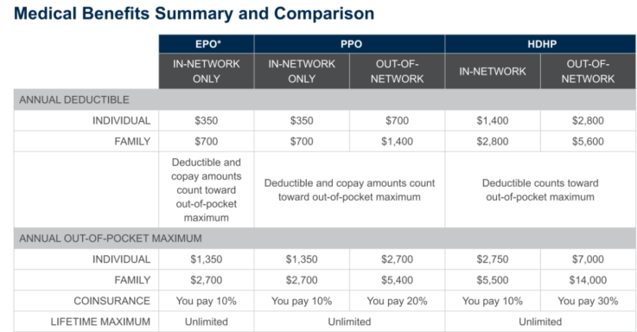
Medical Plan continued
Deductible- the cost you pay before Aetna will pay
Coinsurance- your share of the costs after you meet your deductible
Copay- the flat dollar amount you pay
Out of Pocket maximum- the most you will for medical and prescription services during the year

Slide 8
Teladoc
Teladoc provides access to board-certified doctors and pediatrician, virtually by online video, phone or mobile app.
You can use Teladoc as your Virtual Primary Care
General Medicine
Mental Health
Dermatology
To get started with Teladoc go to www.Teladoc.com/Aetna

Slide 9



Virtual Primary Care
Aetna Virtual Primary Care® powered by Teladoc®
A more connected virtual
primary care experience
In-depth preventive care with biometric-based screening and chronic condition management
Coordination of in-person care, local health care services including labs, tests and more
Built into all plans
Provides access to wide network of specialists and doctors when in-person care is preferred
Dedicated care team access 24/7 via in-app SMS or phone for pre-, during and post-visit support
Member-selected, dedicated, virtual care provider from first 30-45-minute visit to every visit thereafter
$0 copay for virtual primary care provider visits and covered in-person services at MinuteClinic® and CVS® HealthHUBTM locations*
*This information does not apply to members enrolled in qualified high-deductible health plans: members enrolled in qualified high-deductible health plans must meet their deductible before receiving covered non-preventive MinuteClinic services at no cost-share. However, such services are covered at negotiated contract rates. Once the deductible has been met, such members will be able to access MinuteClinic services at no cost-share. Applies only to covered services at MinuteClinic. Aetna and MinuteClinic, LLC (which either operates or provides certain management support services to MinuteClinic-branded walk-in clinics) are both within the CVS Health® family.
9
Notes:
Main message: For some, the digital world has been intimidating or lonely. With our approach to virtual primary care, that is not the case. Members have a provider who stays with them and helps them navigate their personal health journey. They also have a care team and seamless support. This helps reduce gaps in care and encourage consistent engagement. In other words, your employees can develop a trusted relationship and feel at ease. Here’s how it works:
Members can choose a Teladoc doctor for ongoing virtual primary care, not just sick care. Aetna’s Virtual Primary Care Plan connects them to board-certified physicians who are dedicated to their personal health care needs. Members can meet with their virtual care providers by phone, computer, in the comfort of their home or while traveling with $0 out-of-pocket costs.
They’ll have the same virtual care provider for all scheduled visits, as well as a virtual care team to assist with follow-ups and referrals. Virtual Primary Care includes exclusive benefits as shown on slide at no cost to the members for virtual or in-person care at MinuteClinic or CVS HealthHUB for select in person services – no deductible, no copay, and no coinsurance. Employees can also message the team in between visits via the Teladoc app. It’s fast, convenient and confidential.
Support points:
Members build a relationship with a dedicated Care Team and a virtual primary care provider who truly takes the time to get to know the member and healthcare needs.
Members can schedule visits for health concerns, healthcare screenings, imaging needs and managing chronic conditions.
The Care Team is an experienced group of registered nurses, medical assistants and care coordinators that provides additional support and coordinate with members throughout the care journey, 24/7.
Build an ongoing relationship with a therapist or psychiatrist
To access Aetna® Virtual Primary Care, members simply select Aetna Virtual Primary Care in the Teladoc app or online experience. Then, choose a primary care provider and schedule a first visit at a convenient time. Members will receive a FREE blood pressure monitor in the mail.
Note: enhanced referral language for 2022:
Further specialty referral optimization through ingestion of Aetna’s network/site of care referral algorithms into care team workflow to drive precision referrals

Slide 10






General Medical can be used for
Pediatric care for ages two years or older
If there’s no time
for an office visit
If you need a short-term
prescription refill*
If your doctor
is unavailable
If distance makes an
office visit difficult
If you’re on vacation
or a business trip in the U.S.
* Rx limited to two refills for the same diagnosis in a year.
Notes:
There are many instances where a General Medical visit can be used.

Slide 11

Mental Health Care: Confidential, ongoing support
Patients select their choice of board-certified psychiatrists, licensed psychologists, therapists or counselors
Talk to the same therapist on-going for anxiety, eating disorders, depression, grief, family difficulties, and more
Available 7 days a week,
from 7am–9pm local time, by video
Receive discreet and confidential support from wherever the member
is most comfortable
Adolescents ages 13-17 can now receive the same care provided to adults with Mental Health Care*
They can receive support and counseling for issues like:
  Anxiety
  Depression
  Stress
  Family issues
  ADHD
Notes:
Network:
The Teladoc Health network includes board-certified psychiatrists, licensed psychologists, and Master’s Level licensed therapists with a large variety of specialties.
Clinicians are available in all 50 states (note that Psychiatrists are not available in all 50 states)
Scheduling:
A member may request an appt 7 days a week by video between 7:00 am – 9:00 pm local time; however a provider can propose an appt time outside these hours, if mutually agreeable.
Typically, after each session, the provider and member choose together the next session time at the end of the visit.
Costs:
There is a per visit fee for MH Care sessions (see cost slide for particulars)
Masters Level therapists and psychologist visits are for 60 mins, meaning 45-50 minutes of talk time, and then 10-15 min for documentation.
Psychiatry visits, which tend to be more focused on medications vary by initial visit with a psychiatrist or an ongoing session. Initial visits, typically 30 min, focus on medical and Rx history. An ongoing medication management visit is typically 15 mins.
Top 5 Conditions Treated:
Anxiety
Depression
PTSD/Stress
Panic disorder
Family and marriage issues
Other stats
Average 6.1 hours from visit request to therapist response
Average 32 hours for confirmed first appointment
Less than 7 days to first completed therapy visit (average wait for first visit in brick & mortar practice is 30+ days)
50.9% of visits are requested by members between the age of 31-45
20.3% of visits are requested by members between the age of 18-26

Slide 12

Dermatology: Quick, reliable access to skin specialists
Access to board-certified
dermatologists via web or app
Treats acute or ongoing skin conditions like psoriasis, skin infection, rosacea, and more
Images shared to receive a
diagnosis within two business days
Providers can prescribe
approved medications
Follow-up with the doctor
within 7 days after the visit
Notes:
Dermatology is a discrete and secure way to treat a wide array of skin problems like psoriasis, skin infection, rosacea, and more
Members receive access to credentialed dermatologists through the convenience of their computer or smartphone through the Teladoc app.
In brick & mortar settings members can wait months to get an in-person dermatology appt.
And members can share their high-quality images of their skin issue through the secure Teladoc website and receive a diagnosis within 2 business days.

Slide 13
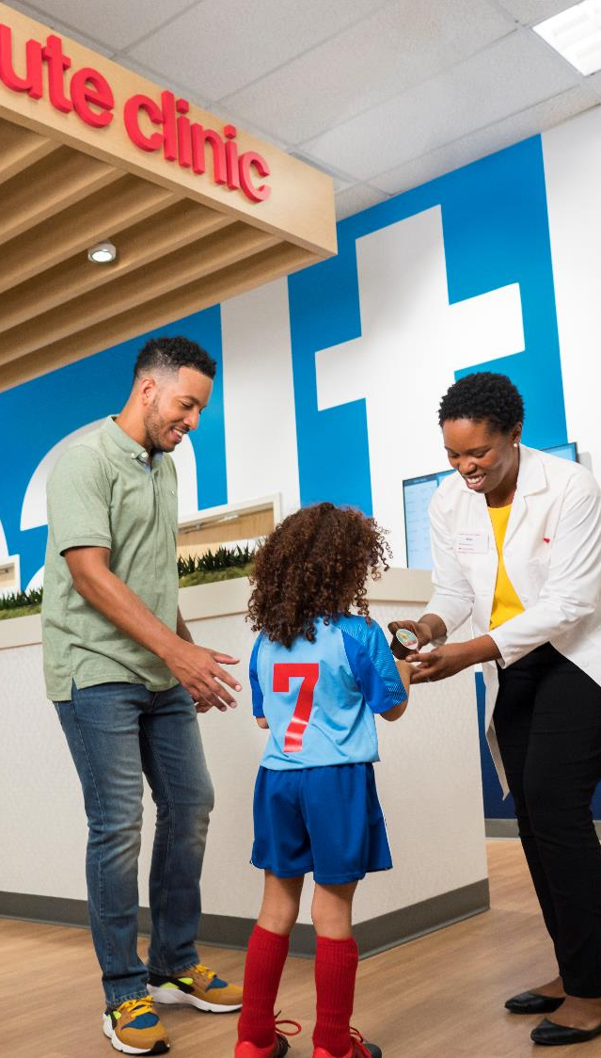

CVS Minute Clinic
Get low cost/no-cost care* at MinuteClinic®
MinuteClinic® services
Minor illnesses and injuries, like allergies, ear infections, flu-like symptoms, bug bites, stings and more
Skin conditions
Wellness and physicals
Screenings and monitoring
Vaccinations and injections
Travel health
Women’s and men’s health services
Obstructive sleep apnea** screening assessment and diagnosis
Point of care lab testing​
MinuteClinic providers can also administer vaccines and write prescriptions, when medically appropriate.
For your best health, we encourage you to have a relationship with a primary care physician or other doctors. Tell them about your visit to MinuteClinic, or MinuteClinic can send a summary of your visit directly to them.
** Sleep apnea screening performed by MinuteClinic.
Your MinuteClinic provider may prescribe a home sleep test, sleep test interpretation and diagnosis by an independent third party.
Access convenient, local care
at MinuteClinic located inside select CVS Pharmacy® and Target locations
Available when you need it,
including nights and weekends.
Get the care you deserve,
without the high out-of-pocket costs.
* Applies only to covered services at MinuteClinic®. Video visits are not a covered service under this visit. Members in indemnity plans are not eligible for this benefit. Such members should refer to their benefit plan documents in order to determine coverage and applicable cost share for clinic benefits and services, as applicable. Visit MinuteClinic.com for age and service restrictions.
The no-cost MinuteClinic benefit is not currently available to HMO membership in CA, Sutter JV membership in CA and members in the Indemnity plans are not eligible. Includes select MinuteClinic® services. Not all MinuteClinic services are covered. Please consult benefit documents to confirm which services are included. Members enrolled in qualified high-deductible health plans must meet their deductible before receiving covered non-preventive MinuteClinic services at no cost-share. However, such services
are covered at negotiated contract rates. This benefit is not available in all states or on indemnity plans.
13
©2021 Aetna Inc.
Notes:
Sometimes things just happen. Your kid develops flu symptoms after your primary care office has closed for the day. You step on a tack over the weekend. We get it, things happen, and when they do, you want to be able to access care at a price you can afford. That’s why we’re offering a perk to eligible Aetna members: access to all covered MinuteClinic services at no cost to you, or low cost to you, based on your plan design.*
MinuteClinic is a walk-in clinic inside select CVS Pharmacy® and Target stores and is the largest provider of retail health care in the United States, making it easy to access care in your neighborhood.
Open 7 days a week, including evenings and weekends. You can walk in or schedule appointments online beforehand. And for even more convenience, you can pick up your prescription on-site.
*Applies only to covered services at MinuteClinic. Video Visits are not a covered service under this Benefit. This information does not apply to members enrolled in qualified high-deductible health plans: such members must meet their deductible. However, such services would be subject to negotiated contract rates. Once the deductible has been met, such members will be able to access MinuteClinic services at no cost-share. Members in indemnity plans are not eligible for this benefit. Such members should refer to their benefit plan documents in order to determine coverage and applicable cost share for walk-in clinic benefits and services, as applicable. Visit minuteclinic.com for age and service restrictions.

Slide 14
Aetna Supplemental Plans
For additional coverage you can purchase any combination of the below three supplemental plans which all provide cash payments if certain conditions are met:
  Critical Illness
  Hospital Indemnity
  Accident
These benefits pay you directly and you decide how you would like to use it such as for
  Deductibles
  Copays
  Mortgage
  Childcare
  Groceries
You enroll in the plans during open enrollment or another qualified life event such as, birth/adoption, marriage, loss of coverage etc. by going to www.myaetnasupplemental.com or downloading the My Aetna Supplemental app or you can access from www.aetna.com

Slide 15
Aetna Critical Illness Plan
How it works
Cash benefits paid for serious illness:
Partial Face Amount cash benefits paid for serious illness:
Heart attack
Stroke
Invasive cancer
Organ failure
Loss of speech, sight or hearing
Coma
Parkinson’s disease
Non-invasive cancer
Coronary by-pass
Health screening
The Aetna Specified Disease plan is designed to help cover out-of-pocket costs related to the diagnosis of a covered serious illness.
Spouse/Child(ren) dependent benefits are equal to the face amount of employee’s benefits.
Rates are based on the employee’s age.
Members receive a lump sum cash benefit upon diagnosis, as specified in their benefit summary.
…and more! Recurrence and subsequent diagnoses* are also covered. See the benefit summary included in your enrollment materials for a full list of benefits and details.
*Recurrence and subsequent diagnoses benefits do not have a waiting period after the initial diagnosis.

Slide 16

Aetna Hospital Indemnity Plan
Cash benefits paid for:
How it works
Initial admission into the hospital*
Daily inpatient hospital stays**
Daily intensive care unit stays**
Daily inpatient rehabilitation, substance abuse, and mental disorder stays**
Newborn routine care
Observation room (1 day per plan year)
The Aetna Hospital Indemnity Plan is designed to help cover out-of-pocket costs related to a planned, or unplanned hospitalization.
Members receive cash benefits for a covered hospitalization.
…and more! See the benefit summary included in your enrollment materials for a full list of benefits and details.
*Hospital admission benefit available to be paid once per plan year per member for initial day inpatient.
**Daily stays start on the second day after an admission. Maximum of 30 days combined for all daily benefits.
©2021 Aetna Inc.

Slide 17
Aetna Accident Plan
Cash benefits paid for:
How it works
Initial care treatment
Ambulance
X-rays & medical imaging
Follow-up care treatment
Fractures & dislocations
Inpatient hospital treatment
Surgical care
Burns
Therapy services
Traumatic brain injury
The Aetna Accident Plan is designed to help cover out-of-pocket costs related to an accident that happens on or off-the-job.
Members receive cash benefits for a variety of accidental injuries and treatment as specified in their benefit summary.
…and more! See the benefit summary included in your enrollment materials for a full list of benefits and details.
©2021 Aetna Inc.

Slide 18
Overview of Benefits
Aetna Employee Assistance Program (EAP)
Benefit Overview
Counseling and Relationship Support
Up to 6 counseling sessions per issue per year with licensed network professionals at no cost
Available face to face, by phone or televideo
For a range of issues such as: work and home life balance, family relationship issues, depression, conflict management, alcohol/substance misuse, stress management and more
Web-based Resources
Customized website offers a full range of tools and resources (most sections are available in Spanish).
Live webinars and on-demand library
Mobile app
Discount Center
Access to worklife service providers
Articles and self –assessments
myStrength—a health club for your mind
Worklife Balance Services
Consultation, information and assistance with locating resources such as: childcare, parenting and adoption, care for older adults, pet care, household services, care kits, etc.
Legal Services
30-minute free consultation for each new legal topic (each plan year)
25% discount off the fees for services beyond the initial consultation
Financial Services
30-minute free telephonic consultation for each new financial topic (each plan year) related to budgeting; retirement and other financial planning; mortgages; credit and debt issues; college funding; tax and IRS questions and preparation
25% discount off the fees for services beyond the initial consultation
You can access Aetna EAP by logging into www.resourcesforliving.com
User ID: Brookfield
Password: EAP

Slide 19

24-Hour Nurse Line
Health information is a phone call away
Aetna Resource-24- Hour Nurse Line
Get information on a wide range of health and wellness topics
Make better health care decisions
Find out more about a medical test or procedure
Get help preparing for a visit to your doctor
Receive emails with links to videos that relate to your question or topic
Contact the Nurse Line at : 1-800-556-1555 (TTY: 711)
19
©2021 Aetna Inc.
28
Notes:
Sometimes your health question can’t wait until your doctor’s visit. Or even the next morning. With the 24-Hour Nurse Line, you can speak to a registered nurse about health issues that are on your mind — whenever you need to. Of course, only your doctor can diagnose, prescribe or give medical advice. But Informed Health Line nurses can provide information on more than 5,000 health topics. They can help you save a trip to the ER or make smarter decisions about your health care.
Plus —
• It’s toll-free.
• You can call as many times as you need — at no extra cost.
• Your covered family members can use it, too.
The 24-Hour Nurse Line can provide helpful information and possibly prevent an unneeded trip to the emergency room (ER). That can be a money-saver. Plus, you’ll be able to make smarter health decisions. You’ll have reliable information you can trust — and it’s only a phone call or click away
Remember to contact your doctor first with any questions or concerns regarding your health care needs.

Slide 20
Aetna Concierge
How can I find the
right specialist?
Health care is
personal, and it’s full of tough questions.
Get personalized support
with a concierge.
Is this covered
under my plan?
I have my diagnosis;
what do I do now?
Aetna concierge is here with answers. 1-888-655-5327
20
©2021 Aetna Inc.
Notes:
At the heart of a simple experience is the Aetna Health Concierge.
Aetna Concierge helps you with whatever you need. We’re available through a single phone number, chat or email.
Our Aetna Health Concierge service connects you to available programs, tools and resources to provide you with right solutions at the right times. Care team representatives stand by to explain benefits, answer benefits questions and walk you through tools step by step at your convenience.
Imagine. You call to ask about maternity benefits. After answering the benefit questions, the concierge gets a system alert (a smart edit) that our maternity nurse has been trying to reach you. The concierge takes action and immediately connects you with the nurse — to help ensure that you have a healthy pregnancy and baby. She can even connect you with your employee assistance program for access to valuable work life benefits that support new mothers.

Slide 21
Thank You
Questions

